Slide 1
The Recording Process

Slide 2
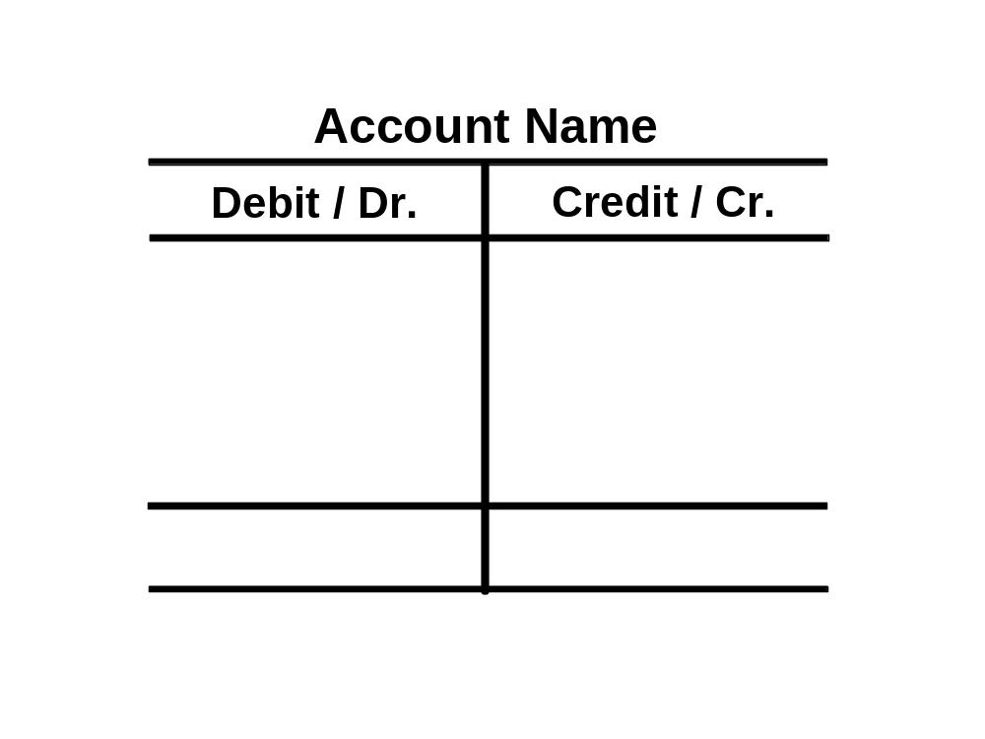

The Account
Record of increases and decreases in a specific asset, liability, equity, revenue, or expense item.
Debit = “Left”
Credit = “Right”
Account
An Account can be illustrated in a T-Account form.

Slide 3
Debits and Credits
Double-entry accounting system
Each transaction must affect two or more accounts to keep the basic accounting equation in balance.
Recording done by debiting at least one account and crediting another.
DEBITS must equal CREDITS.

Slide 4

Debits and Credits
If Debits are greater than Credits, the account will have a debit balance.
Transaction #1
$10,000
$3,000
Transaction #2
Transaction #3
8,000
Balance
$15,000

Slide 5
Debits and Credits
If Credits are greater than Debits, the account will have a credit balance.
Transaction #1
$10,000
$3,000
Transaction #2
8,000
Transaction #3
Balance
$1,000

Slide 6
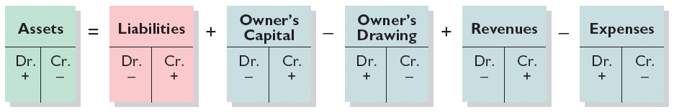
Expansion of the Basic Equation
Relationship among the assets, liabilities and owner’s equity of a business:
Basic Equation
Assets
=
Liabilities
+
Owner’s Equity
Expanded Basic Equation
The equation must be in balance after every transaction. For every Debit there must be a Credit.

Slide 7
Debits and Credits Summary
Review Question
Accounts that normally have debit balances are:
  assets, expenses, and revenues.
  assets, expenses, and owner’s capital.
  assets, liabilities, and owner’s drawings.
  assets, owner’s drawings, and expenses.

Slide 8
Debits and Credits Summary
Discussion Question
Q. Maria Alvarez, a beginning accounting student, believes debit balances are favorable and credit balances are unfavorable. Is Maria correct? Discuss.
Notes:
Question 2-4 (textbook) Maria is incorrect. A debit balance only means that debits amounts exceed credit amounts in an account. Conversely, a credit balance only means that credit amounts are greater than debit amounts in an account. Thus, a debit or credit balance is neither favorable nor unfavorable.

Slide 9
The Journal
Book of original entry.
Transactions recorded in chronological order.
Contributions to the recording process:
  Discloses the complete effects of a transaction.
  Provides a chronological record of transactions.
  Helps to prevent or locate errors because the debit and credit amounts can be easily compared.

Slide 10
Journalizing
Journalizing - Entering transaction data in the journal.
(Facts) Presented below is information related to Hanshew Real Estate Agency.
Oct. 1
Pete Hanshew begins business as a real estate agent with a cash investment of $15,000.
3
Purchases office furniture for $1,900, on account.
6
Sells a house and lot for B. Kidman; bills B. Kidman $3,200 for realty services provided.
27
Pays $700 on balance related to transaction of Oct. 3.
30
Pays the administrative assistant $2,500 salary for Oct.
Instructions - Journalize the transactions for E2-4.

Slide 11
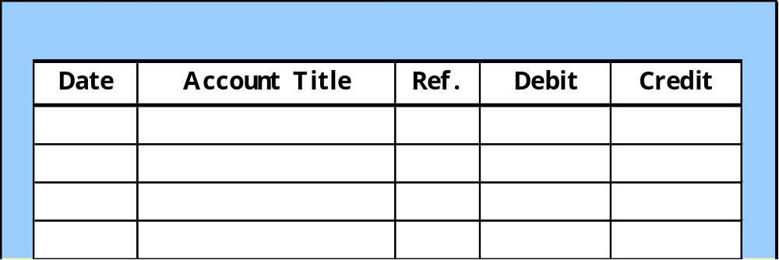
Journalizing
(Facts) Journalize the transactions related to Hanshew Real Estate Agency.
Oct. 1
Pete Hanshew begins business as a real estate agent with a cash investment of $15,000.
General Journal
Oct. 1
Cash
15,000
  Hanshew, capital
15,000
(Owner’s investment)

Slide 12
Journalizing
(Facts) Journalize the transactions related to Hanshew Real Estate Agency.
Oct. 3
Purchases office furniture for $1,900, on account.
General Journal
Oct. 3
Office furniture
1,900
  Accounts payable
1,900
(Purchase on account)

Slide 13
Journalizing
(Facts) Journalize the transactions related to Hanshew Real Estate Agency.
Oct. 6
Sells a house and lot for B. Kidman; bills B. Kidman $3,200 for realty services provided.
General Journal
Oct. 6
Accounts receivable
3,200
  Service revenue
3,200
(Services provided)

Slide 14
Journalizing
(Facts) Journalize the transactions related to Hanshew Real Estate Agency.
Oct. 27
Pays $700 on balance related to transaction of Oct. 3.
General Journal
Oct. 27
Accounts payable
700
  Cash
700
(Payment on account)

Slide 15
Journalizing
(Facts) Journalize the transactions related to Hanshew Real Estate Agency.
Oct. 30
Pays the administrative assistant $2,500 salary for Oct.
General Journal
Oct. 30
Salaries expense
2,500
  Cash
2,500
(Payment for salaries)

Slide 16
Journalizing
Simple Entry – Two accounts, one debit and one credit.
Compound Entry – Three or more accounts.
Example – On June 15, H. Burns, purchased equipment for $15,000 by paying cash of $10,000 and the balance on account (to be paid within 30 days).
General Journal
Jun. 15
Equipment
15,000
  Cash
10,000
  Accounts payable
5,000
(Purchase equipment)

Slide 17
The Ledger
A General Ledger contains the entire group of accounts maintained by a company.
The General Ledger includes all the asset, liability, owner’s equity, revenue and expense accounts.

Slide 18
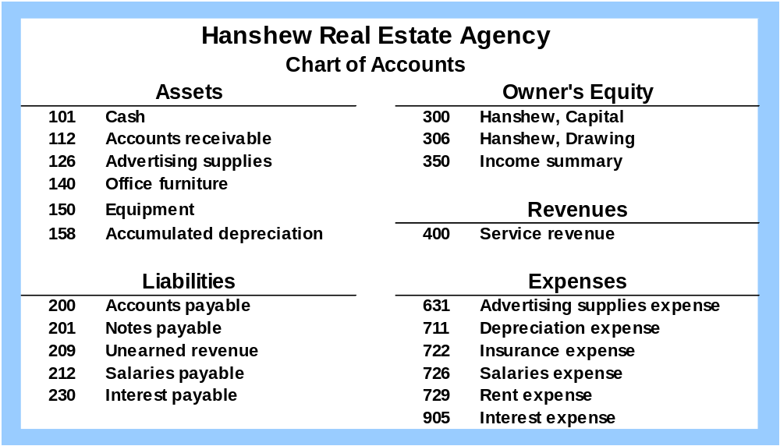
Chart of Accounts
Accounts and account numbers arranged in sequence in which they are presented in the financial statements.

Slide 19
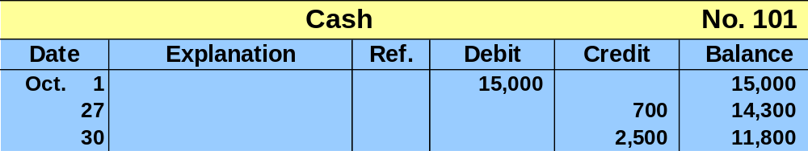
Standard Form of Account
T-account form used in accounting textbooks.
In practice, the account forms used in ledgers are
much more structured.

Slide 20
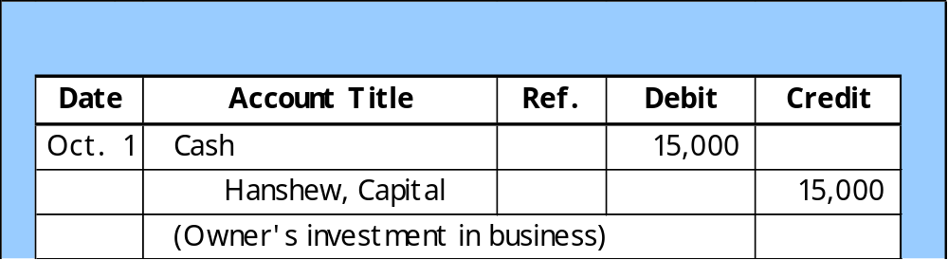
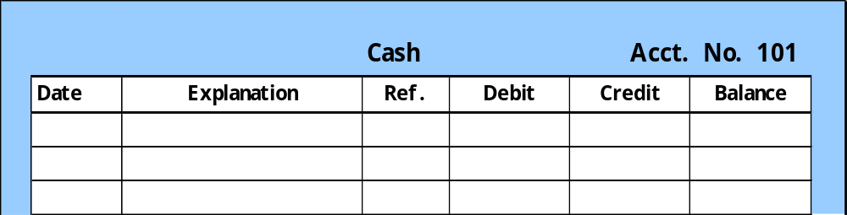
Posting
Posting – the process of transferring amounts from the journal to the ledger accounts.
General Journal
J1
101
General Ledger
Oct. 1
J1
15,000
15,000

Slide 21
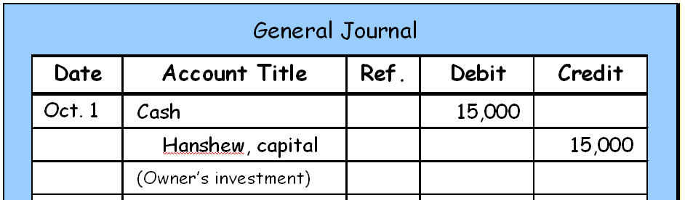
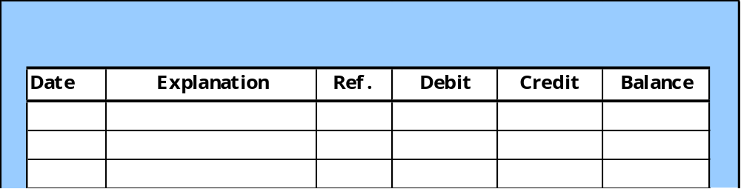
J1
Posting
101
300
General Ledger
Cash
Acct. No. 101
Oct. 1
J1
15,000
15,000
General Ledger
Hanshew, capital
Acct. No. 300
Oct. 1
J1
15,000
15,000

Slide 22
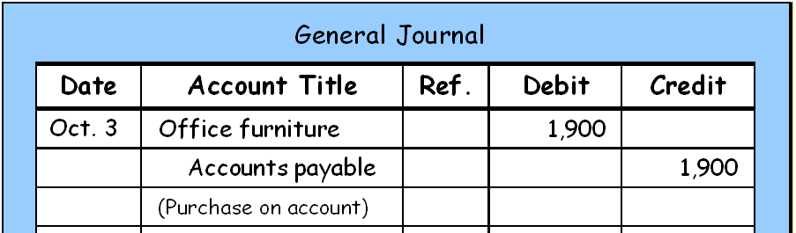
Posting
J1
140
200
General Ledger
Office Furniture
Acct. No. 140
Oct. 3
J1
1,900
1,900
General Ledger
Accounts Payable
Acct. No. 200
Oct. 3
J1
1,900
1,900
SO 6 Explain what posting is and how it helps in the recording process.

Slide 23
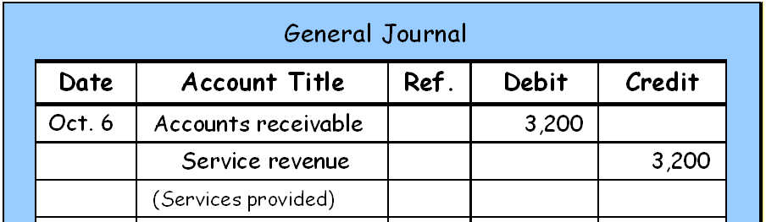
J1
Posting
112
400
General Ledger
Accounts Receivable
Acct. No. 112
Oct. 6
J1
3,200
3,200
General Ledger
Service Revenue
Acct. No. 400
Oct. 6
J1
3,200
3,200
SO 6 Explain what posting is and how it helps in the recording process.

Slide 24
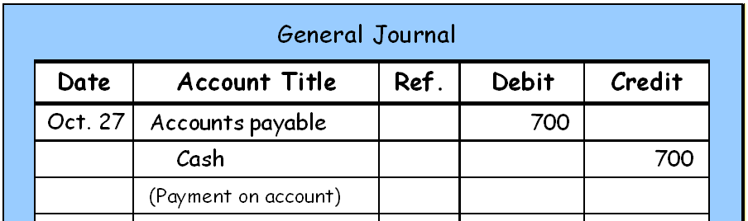
J1
Posting
200
101
General Ledger
Cash
Acct. No. 101
Oct. 1
J1
15,000
15,000
Oct.27
J1
700
14,300
General Ledger
Accounts Payable
Acct. No. 200
Oct. 3
J1
1,900
1,900
Oct.27
J1
700
1,200

Slide 25
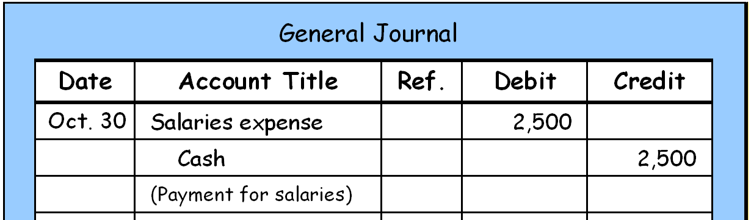
J1
Posting
726
101
General Ledger
Cash
Acct. No. 101
Oct. 1
J1
15,000
15,000
Oct.27
J1
700
14,300
Oct.30
J1
2,500
11,800
General Ledger
Salaries Expense
Acct. No. 726
Oct.30
J1
2,500
2,500

Slide 26
Posting
Review Question
Posting:
  normally occurs before journalizing.
  transfers ledger transaction data to the journal.
  is an optional step in the recording process.
  transfers journal entries to ledger accounts.
SO 6 Explain what posting is and how it helps in the recording process.

Slide 27
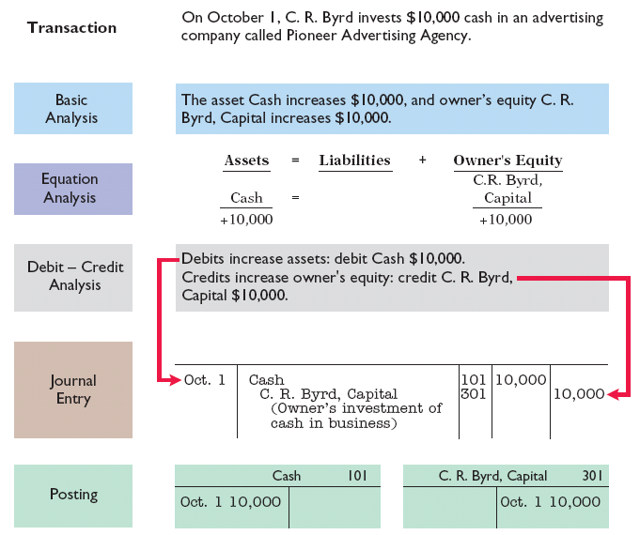
The Recording Process Illustrated
Follow these steps:
1. Determine what type of account is involved.
2. Determine what items increased or decreased and by how much.
3. Translate the increases and decreases into debits and credits.
Illustration 2-19

Slide 28
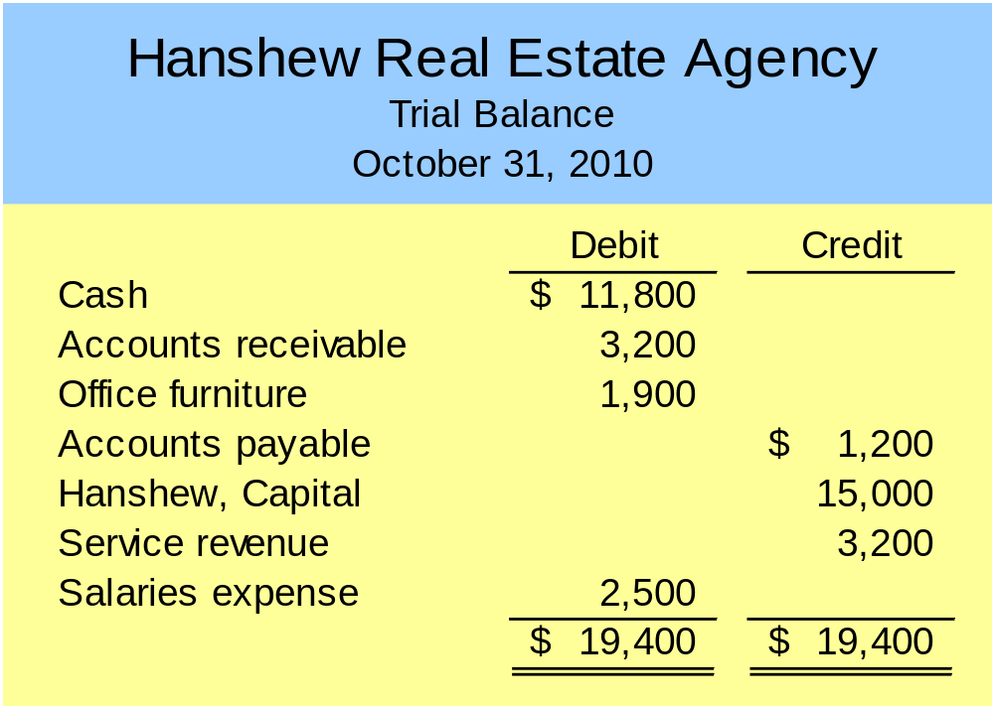
The Trial Balance
A list of accounts and their balances at a given time.
Purpose is to prove that debits equal credits.
E2-5

Slide 29
The Trial Balance
Limitations of a Trial Balance
The trial balance may balance even when
  a transaction is not journalized,
  a correct journal entry is not posted,
  a journal entry is posted twice,
  incorrect accounts are used in journalizing or posting, or
  offsetting errors are made in recording the amount of a transaction.

Slide 30
The Trial Balance
Review Question
A trial balance will not balance if:
  a correct journal entry is posted twice.
  the purchase of supplies on account is debited to Supplies and credited to Cash.
  a $100 cash drawing by the owner is debited to Owner’s Drawing for $1,000 and credited to Cash for $100.
  a $450 payment on account is debited to Accounts Payable for $45 and credited to Cash for $45.

Slide 31
Recording Process
Discussion Question
Q. Jim Benes is confused about how accounting information flows through the accounting system. He believes the flow of information is as follows.
  Debits and credits posted to the ledger.
  Business transaction occurs.
  Information entered in the journal.
  Financial statements are prepared.
  Trial balance is prepared.
Is Jim correct? If not, indicate to Jim the proper flow of the information.
Notes:
Question 2-19 (textbook) No, Jim is not correct . The proper sequence is as follows :
( b ) Business transaction occurs.
( c ) Information entered in the journal.
( a ) Debits and credits are posted to the ledger.
( e ) Trial balance is prepared.
( d ) Financial statements are prepared.

